Slide 1
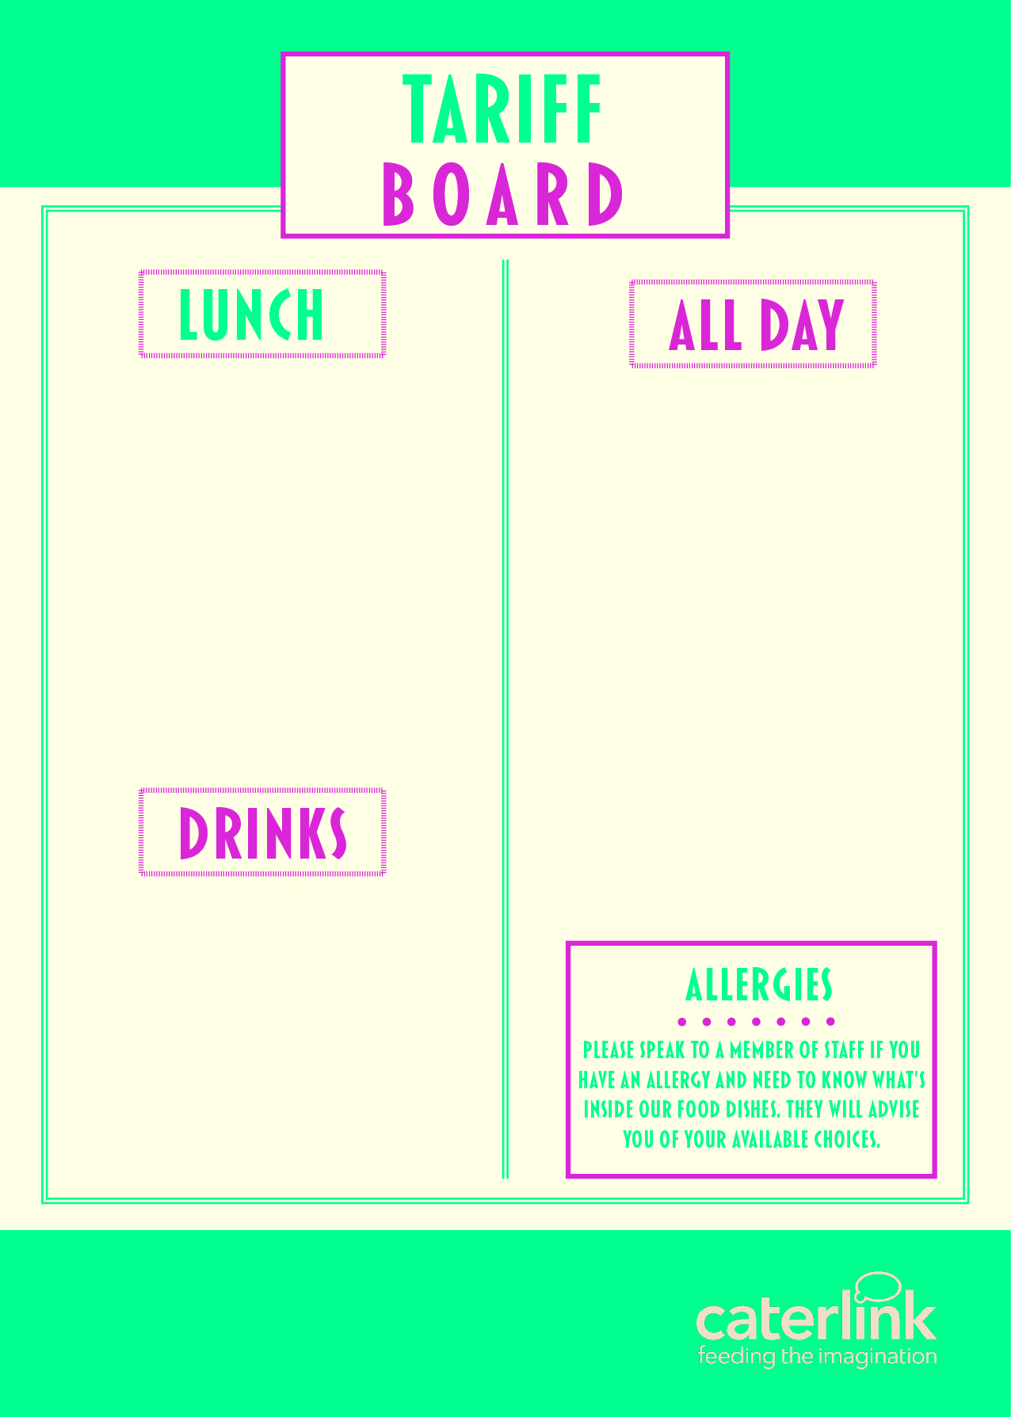
MEAL DEAL (HOT MEAL OF THE DAY + SALAD OR VEGETABLES + HOMEMADE COOKIE OR CAKE) | £2.53
PIZZA SLICE | £1.55
JACKET POTATO & 2 FILLINGG | £2.20
PASTA, SAUCE & CHEESE | £2.20
PANINI (2 FILLINGS) | £2.20
HOMEBAKE | £1.00
COOKIE | £1.00
SANDWICHES / BAGUETTES FROM | £2.20
FRUIT POTS | £1.65
WRAPS FROM | £2.20
SALAD POTS FROM | £2.00
CHIPS / WEDGES | £1.35
SAUSAGE ROLLS | £1.35
HOT FILLED ROLLS | £2.20
CROISSANT | £1.30
PAIN AU CHOCOLAT | £1.30
BEEF / CHICKEN BURGER | £2.20
WATER | £1.05
RADNOR FIZZ | £1.20
RADNOR SPLASH | £1.20
OMJ CANS | £1.20
JUICE CARTONS | £1.00

