Slide 1
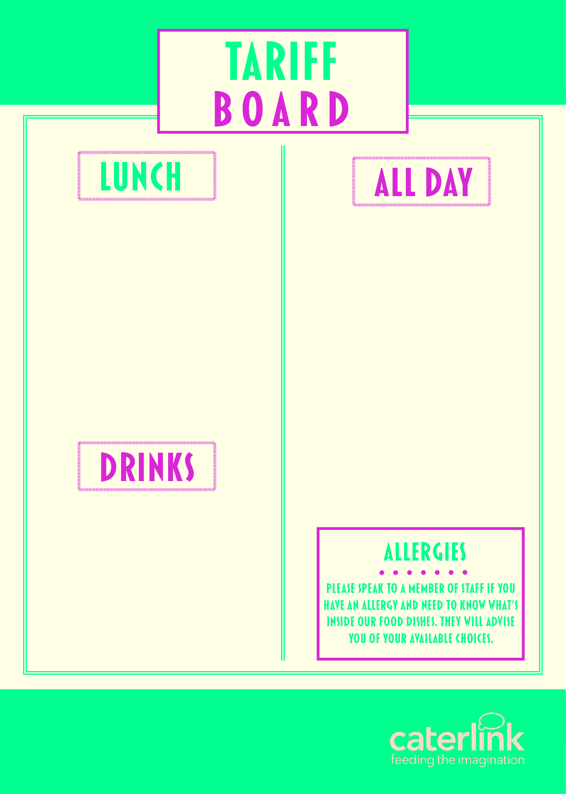
MAIN MEAL (FSM) – HOT | £2.41
MAIN MEAL (FSM) - COLD | £2.41
HOT DESSERT | £0.95
PIZZA SLICE | £1.45
JACKET POTATO & 1 FILLING | £1.75
PASTA & SAUCE SMALL | £1.50
PASTA SAUCE LARGE | £2.15
PANINI (JUST CHEESE) | £1.90
PANINI (2 FILLINGS) | £2.25
HOMEBAKE | £0.95
COOKIE | £0.95
SANDWICHES FROM | £2.00
BAGUETTES FROM | £2.00
WRAPS FROM | £2.05
SALAD POTS FROM | £1.95
FRUIT POTS FROM | £0.80
SAUSAGE ROLLS | £1.20
BACON/SAUSAGE BAP | £1.60
CROISSANT | £1.10
PAIN AU CHOCOLAT | £1.10
WAFFLE | £1.20
X2 HASH BROWNS | £1.10
BURGER BAKED CRISPS FROM | £1.80 £1.00
CHICKEN BURGER | £2.05
WATER | £1.00
FLAVOURED WATER | £1.10
VIVA MILKSHAKE | £0.80
SUSO | £1.20
CAPRI SUN | £0.95

